Slide 1

BRITISH AIRWAYS
Web scraping to gain company insights

Slide 2
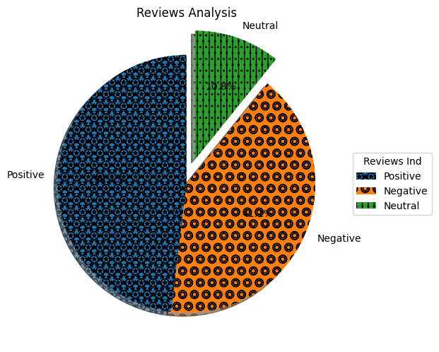
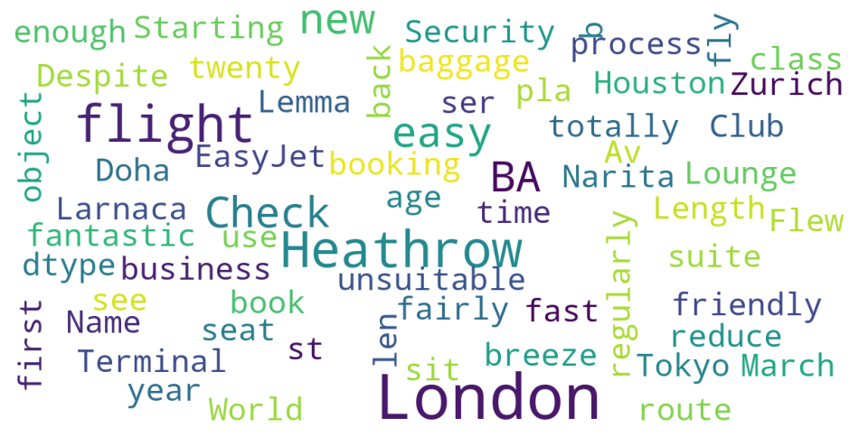
INSIGHTS FROM CUSTOMER REVIEWS
Positive Reviews - 481
Negative Reviews - 411
Neutral Reviews – 108

